Slide 1
Kindness is a Super Power
Notes:
Energy is key! Show the kids you are excited to be there, and they will match your energy
Start with “Good morning students!” or “Are you excited to be here?!”
If morale is low, you can start with a challenge between the two sides of the room saying “Be Kind” as loud as they can and pick a winner
Explain to the students that you are there to talk about how kindness gives them superpowers and that they didn’t know but when they walked through those doors, they entered a superhero training day! They are all going to walk out the doors after the assembly is done being superheroes!

Slide 2
“We all have the capacity to be a Superhero. To become one, you just have to find your unique power or ability and exploit it for the greater good. The cape and mask are optional accessories, but a kind heart is essential.”
Robert Clancy
Notes:
Read it yourself or have a student read it out loud (if you read it and get to the word “exploit” replace it with …. “Find your unique power or ability and exploit it – or use it – for the greater good.” This is to keep the wording simple for all kids to understand
Explain that every student there is unique and that is the beauty of this! Everyone is going to do kindness differently, but everyone is important.
Ask what they learned from the quote “It’s not the cape or the mask that is important…it’s what?” – and you can help them out to say “KIND HEART” out loud and ask them to say it again aloud all together if the first time was a little scattered and not energetic

Slide 3
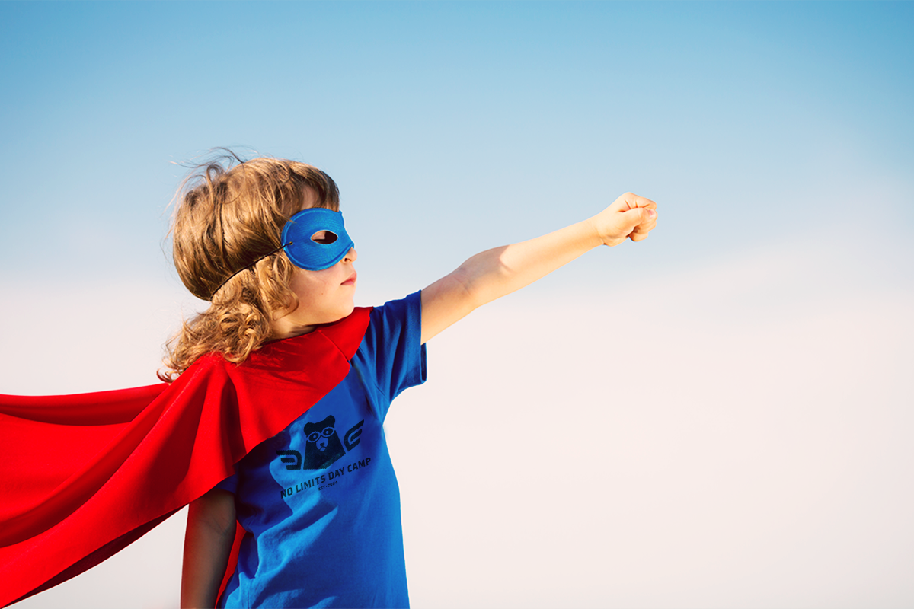
Your
Notes:
Before we get started talking about what powers kindness gives them, ask them what their favorite superheroes are. Just have students answer rapid fire so you don’t spend your whole time of this question.
Walk to different parts of the crowd to ask what their favorite superheroes are to give different students a chance to answer

Slide 4
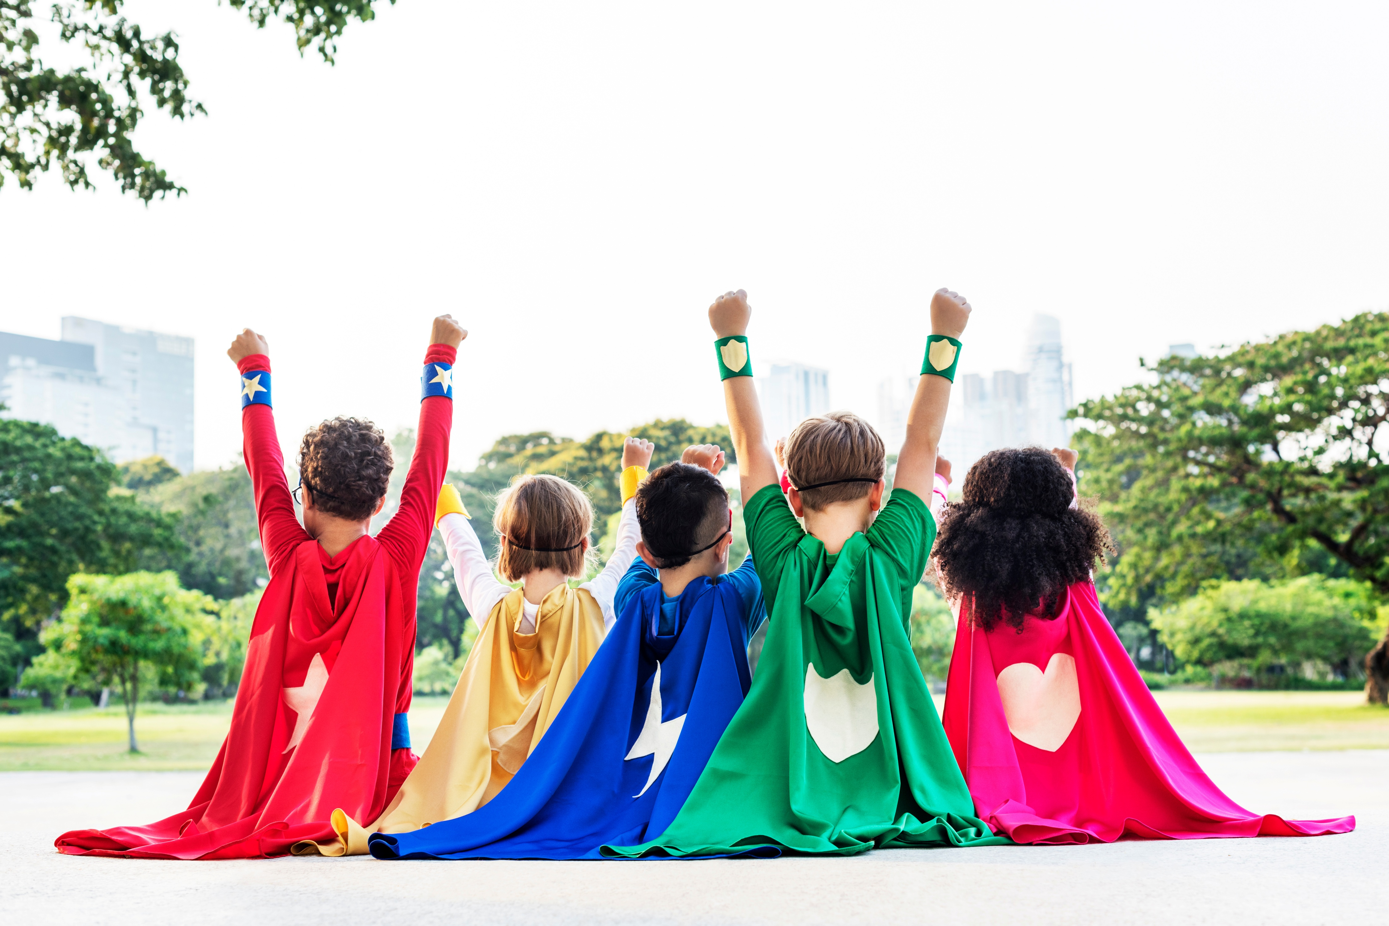
Kindness makes you bulletproof!
Notes:
Their first power is being bulletproof! If they are an older crowd, ask them what they think this means or in what ways kindness can make them bulletproof.
Explain that sometimes people’s words or actions can act as bullets and hurt our hearts but when we choose to be kind even when those things happen to us, we become resilient to those situations and we can use kindness like a shield
Make them make a hand motion like they have a shield

Slide 5
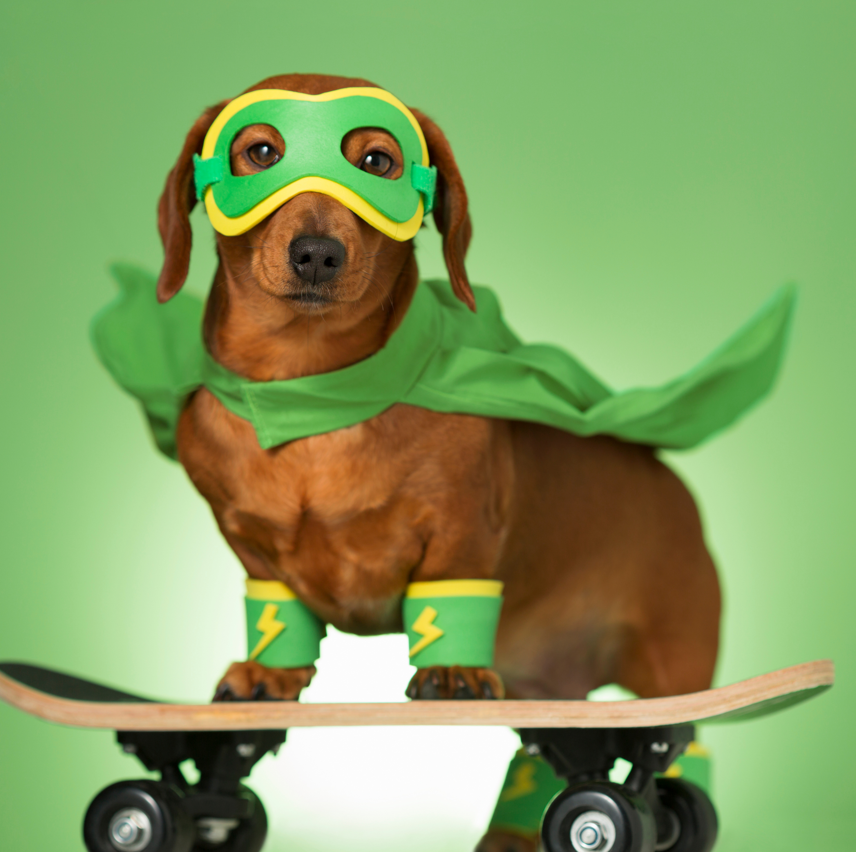
Kindness DISARMS
the attacker
By responding with kindness to those who are unkind, we take the power away from them.
Notes:
Kids go crazy over the dog – I named him Moose and I usually ask the kids to wave and say “HI MOOSE” and then I calm them down
I explain that Moose taught me an important lesson that Kindness disarms the attacker…meaning that when we respond with kindness to those who are unkind we take their powers away.
Ask if any of them have seen the movie Marvel Endgame. Ask them to shout out who the villain was. [they will say Thanos]. That movie would have been five minutes if those superheroes had this power. They are cooler than spiderman and iron man because they have this power.
Give an example of what this could look like – for example if they are at recess and there is someone that didn’t let them play their game with them. That is not kind. But if the next day you start playing a game and invite them even though they weren’t nice to you, you can take away their power and they stop and think “why were they nice to me if I wasn’t nice to them? Maybe I can be kind next time”

Slide 6
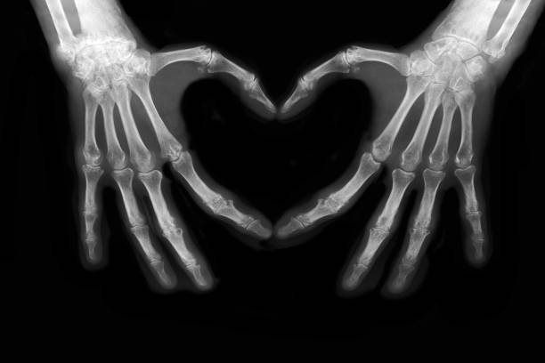
Kindness Give You
X-Ray Vision
Notes:
Ask the kids what they think this means
Have them do a hand signals as if they had binoculars on (they x-ray vision goggles)
Say “I want to see everyone with their kindness vision googles on”
Explain that when we choose to be kind we can see beyond what is actually happening
Give an example – like when someone comes to school and they aren’t being nice that day and are angry you can stop. Put your kindness goggles on. And think that maybe they just didn’t have breakfast and they’re a little hangry. Or there’s something else going on in their lives that is making them sad or upset but even when they are acting that way and choosing to be unkind you can still choose to be kind to them because everyone deserves to be treated with dignity and kindness

Slide 7
Kindness lets you SMASH down walls!
You can get around the barriers as you break down walls between you and other people.
Notes:
In this slide give the instructions that without touching anyone around them practice punching and smashing down a wall
Explain that every one of us in different in a beautiful way – we like different foods, colors, have different music we listen to. Sometimes when we see those differences we build walls and think “I can’t be their friend. They are different than me” but again have them practice smashing the walls.
With kindness we can break down those walls of differences and realize that we all have things in common and everyone can use a friend

Slide 8
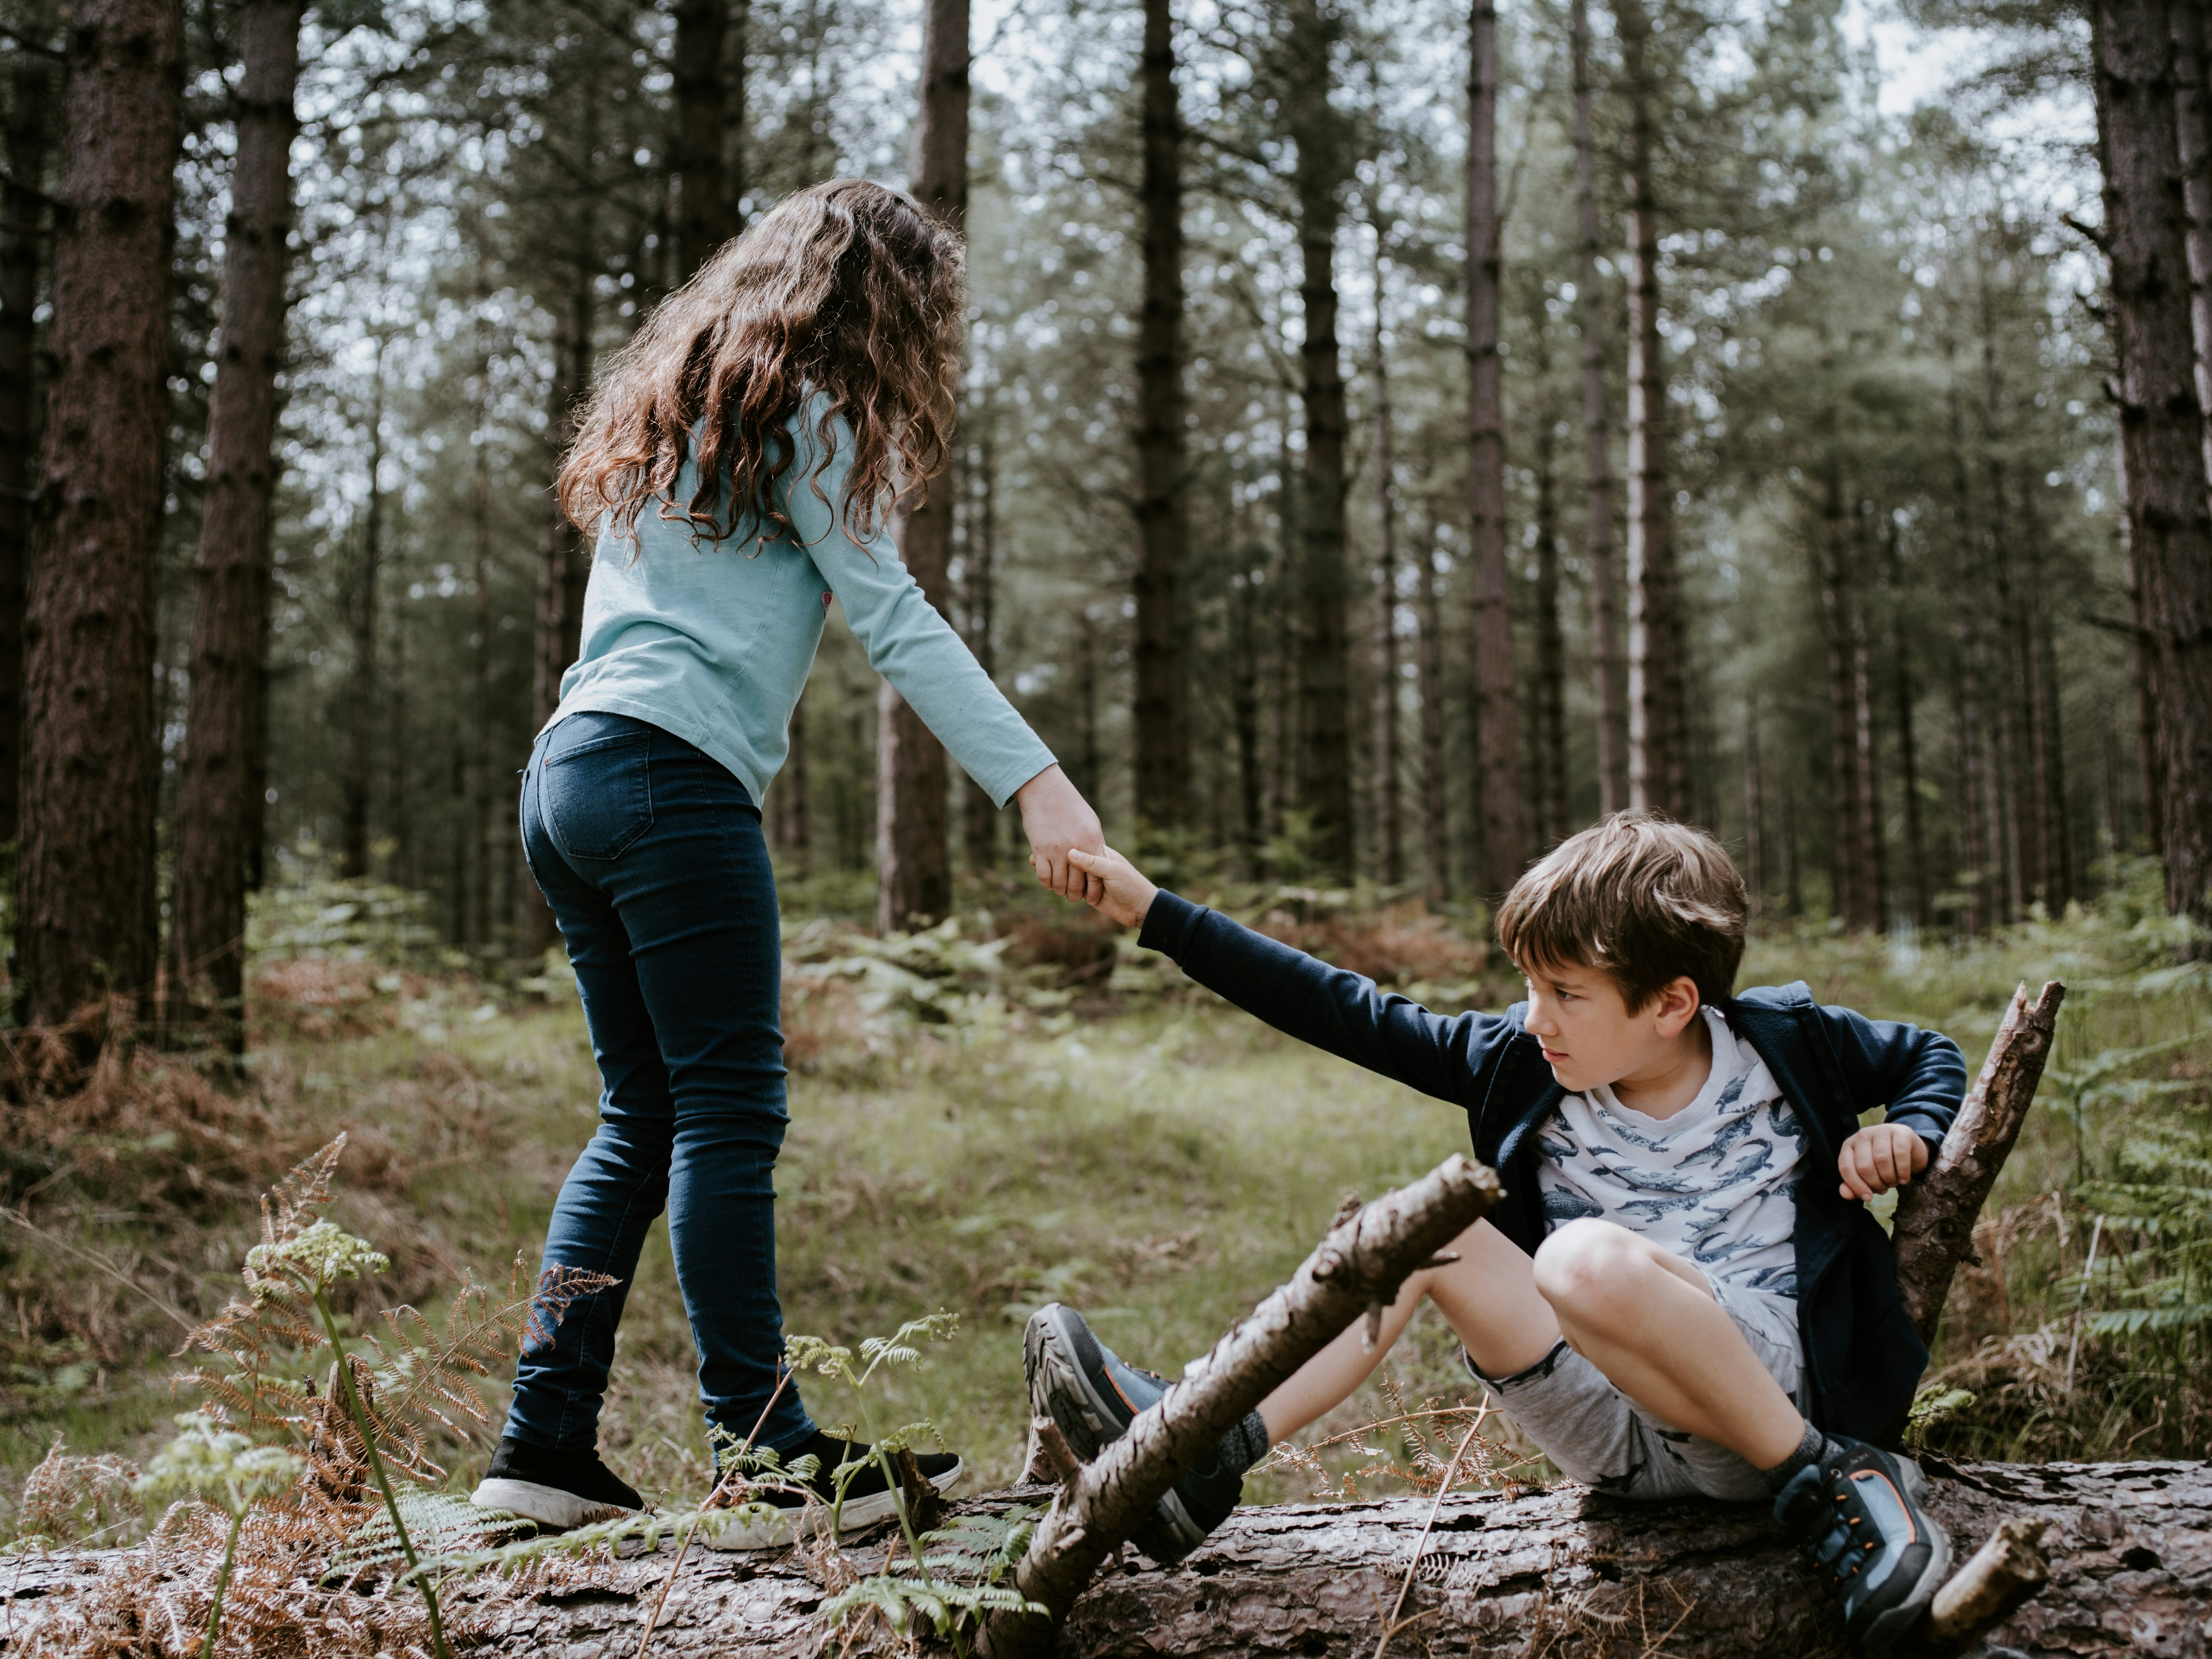
Kindness gives you protection
Friends
Connections
Relationships
Notes:
As you practice kindness you will be able to make new friends and connections and in turn they will be like a protection to you helping you up when you have a hard day and be on your team when you are feeling down
Ask them who is their best friend and why. Have several people answer
Explain that we all like to have friends at school and it makes it so much better to have a friend so let’s be that friend for someone else

Slide 9
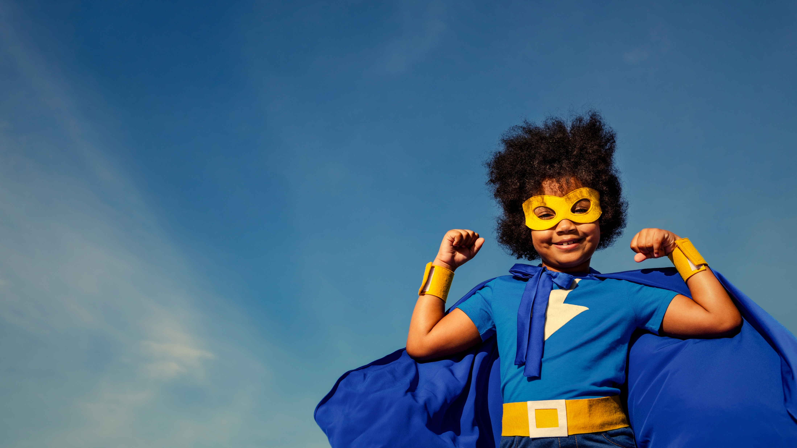
Kindness makes you
Notes:
Make sure the kids are all settled down and then ask the teachers or the student government to come up to the front (or just stand up if there isn’t enough room)
Explain that each teacher or student must come up with their best superhero pose and that the kids will cheer the loudest for the one who wants to win. I usually have an OKAAD water bottle to give to the winner.
Then you go through each teacher and whoever wins gets the water bottle and then they go back to their seats – while that happens explain that you did that little exercise because teachers are the best superheroes and they will be there to show you how to be the best superhero. They can help when you don’t know how to react to a difficult situation and they will help you grow. Have them cheer for all the teachers one more time.
Explain that sadly being kind doesn’t magically turn us to the Hulk and give us mega muscles but what it does do is strengthen our heart that is also a muscle.

Slide 10
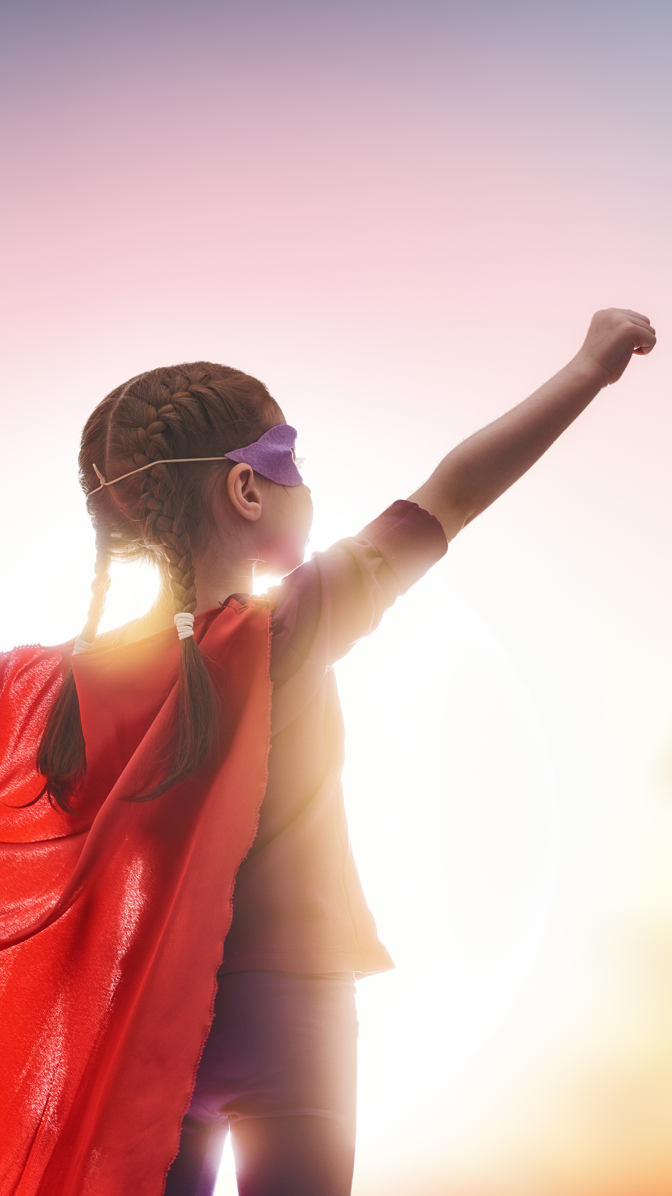
Heroes help other people
No better way to help someone than to include them or make them feel loved.
Notes:
Now that they know all their superpowers explain that now they have to go on missions and help people
Remind them that this assembly is the kickoff to their kindness initiative and that they need to be kind throughout the whole duration of it and hopefully for the rest of their lives.
Ask them “What is a kind thing you can do at school?” Have several people answer

Slide 11
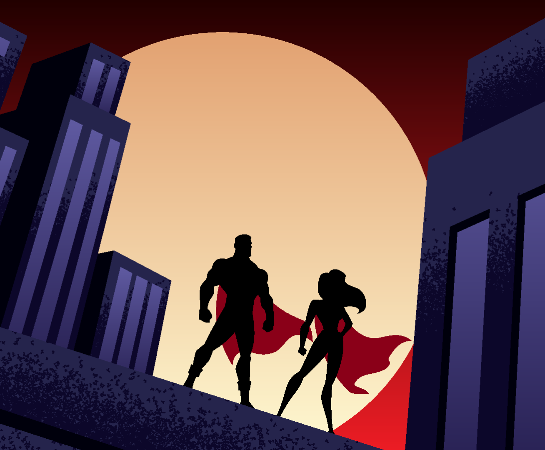
Kindness Spreads
Kindness travels faster than a speeding bullet!
Notes:
The great thing about kindness is that it spreads really fast – as fast as superman can fly!
When we do a kind act it starts with one person but then it spreads really far because then we inspire others around us to do kind things too.
Show this principle with doing the wave – run from one side to the next and say that that’s how fast kindness will spread at the school

Slide 12
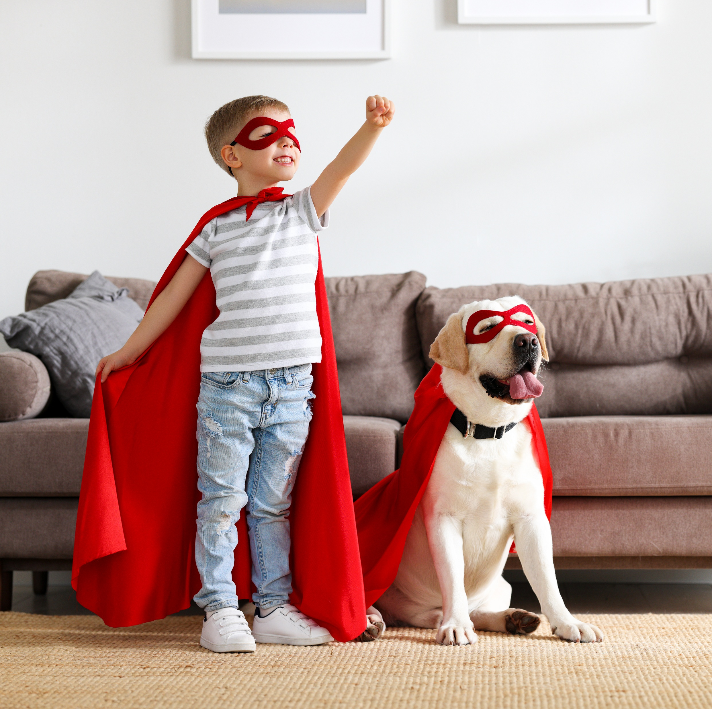
Surround Yourself with Kindness
“Kindness is the most effective way to improve your well-being and the well-being of another person at the same time.”
-Pressman et al., 2015
Notes:
When we are kind, we not only make others around us happy but we end up being happy too
Ask everyone to show their biggest smiles – SO much happiness in this room! Your teachers and parents and friends want to see those big smiles as you do kind things

Slide 13
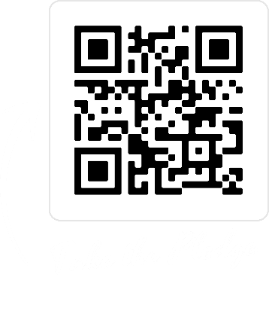
HOW WILL
YOU SAVE THE
WORLD WITH
KINDNESS?
Notes:
Leave them with this posing question for them to think about and give any closing thoughts
You can close again with the competition of having both sides of the room saying “BE KIND” as loud as they can or remind them of the beginning quote and ask them what the most important thing is. Answer: “A KIND HEART!”

