Slide 1




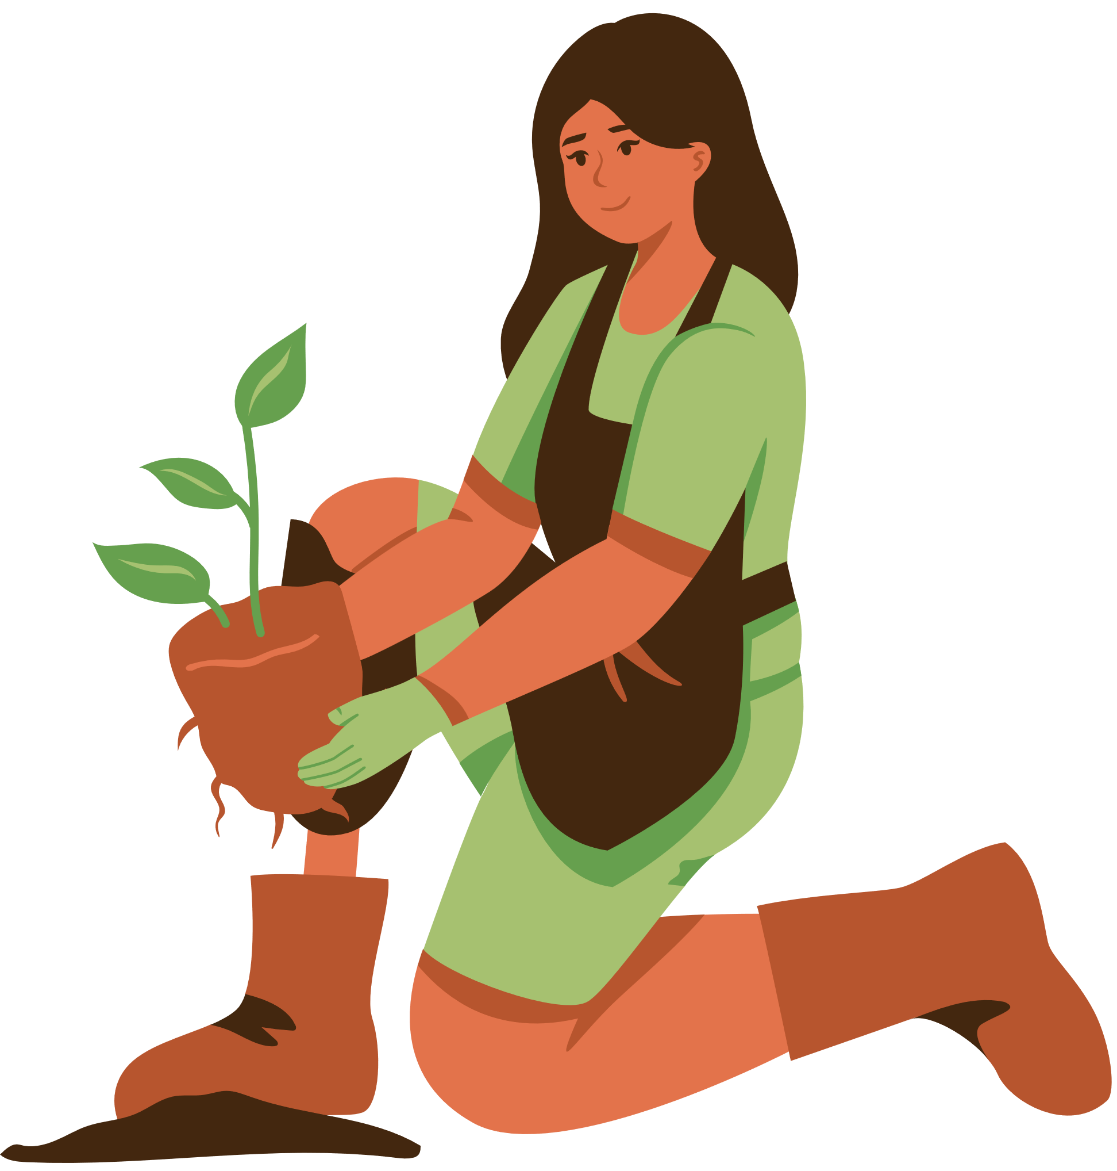
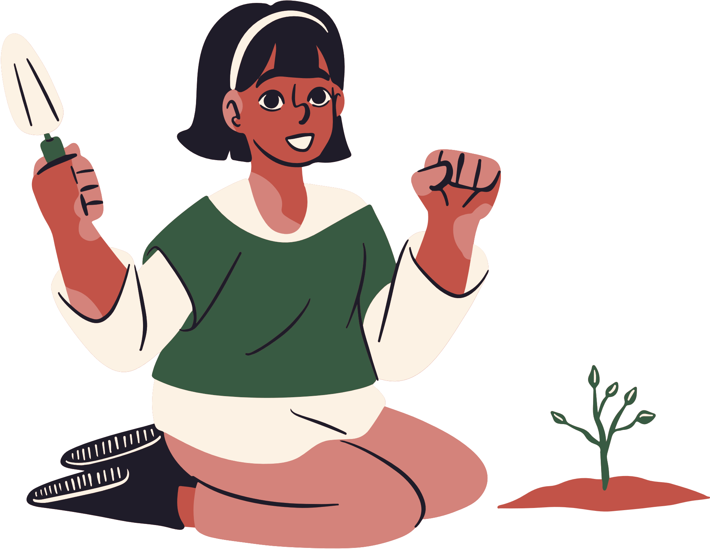


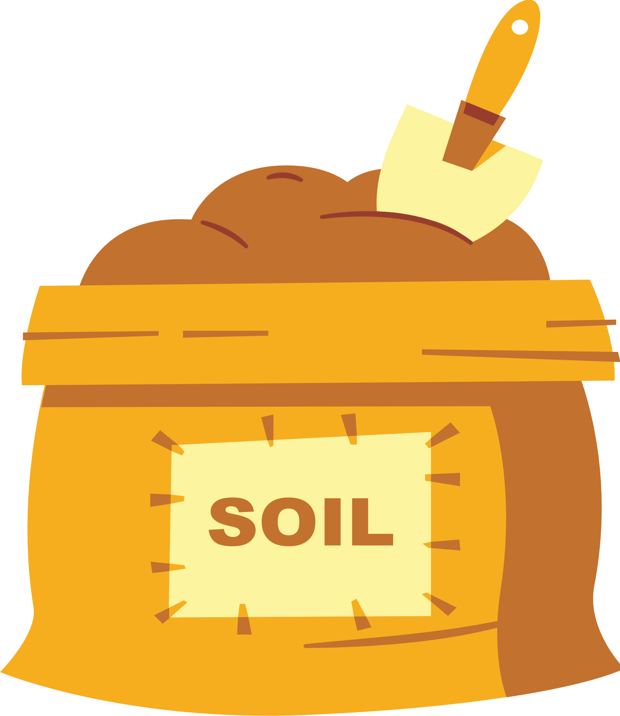
Kindness Grows
Notes:
Energy is key! Start the presentation by showing the students you are excited to be there and they will hopefully match your energy
Introduce yourself and explain you are working together with One Kind Act a Day to bring this presentation to them and that it’s going to be all about how Kindness Grows!
Start with a small activity to get the students engaged. For example, for elementary school students you can have them mimic you and start crouched down in a ball and then quickly open up and stand up with arms wide open (maybe even include a small jump in there) as if the students were seeds growing and have them say “KINDNESS GROWS!” out loud as they are doing the action of opening up

Slide 2




KINDNESS GROWS
YOUR HEART
Your heart is a muscle and when you are kind you make it grow stronger. You also end up being more happy at the end of the day
Notes:
Introduce the title of the slide and have students hold their hands to their hearts
Explain that their hearts are a muscle and that when you choose to practice kindness you can make that muscle grow stronger and stronger.
Share that sometimes we have sad days but that when we choose to be kind we have more happy days.
Have them do a heart shape with their hands to their chest and ask them how their heart is going to grow if they are kind. Have them slowly move their heart shaped hand away from their chest and have them move it in front of them as if their heart is growing until it burst and they shoot their heart nice and big in front of them. Again have them say “KINDNESS GROWS!”

Slide 3


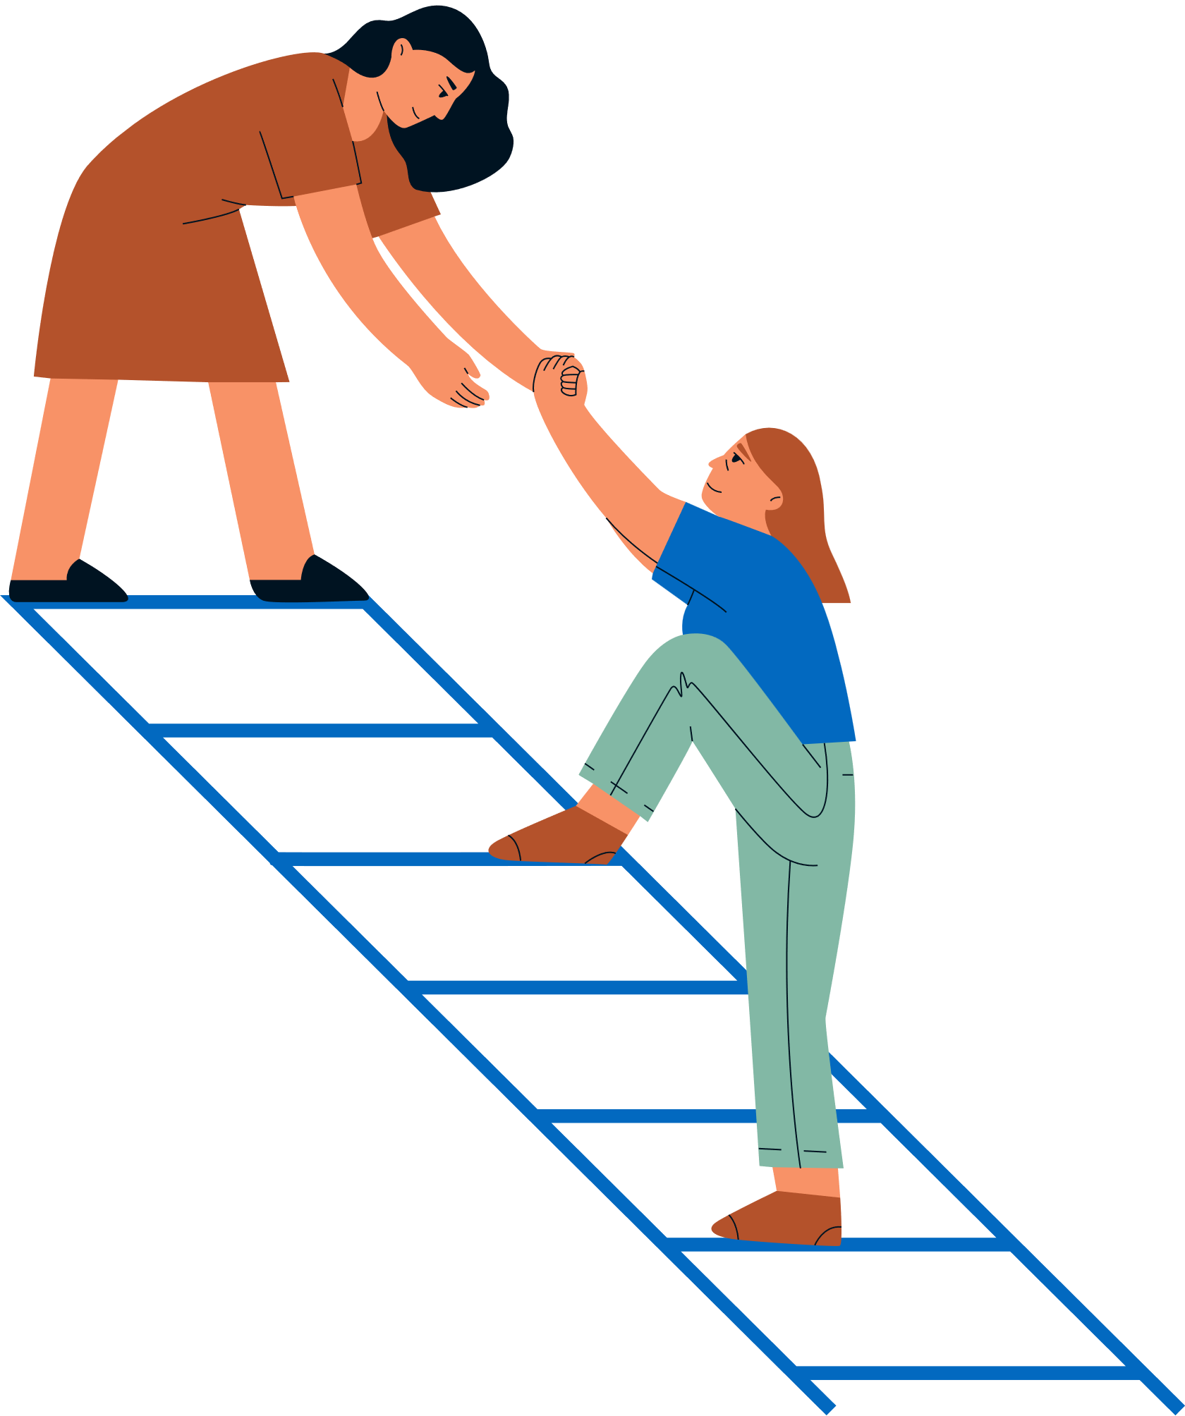

KINDNESS HELPS OTHERS GROW
When you’re kind, others feel supported and encouraged to be their best
Notes:
Explain that when we are kind, others feel supported and encouraged to be their best!
Ask students to share ideas of kind acts they can do to help others grow. Have several students answer. Remember to walk to different parts of the crowd to allow different students to answer and keep them engaged

Slide 4




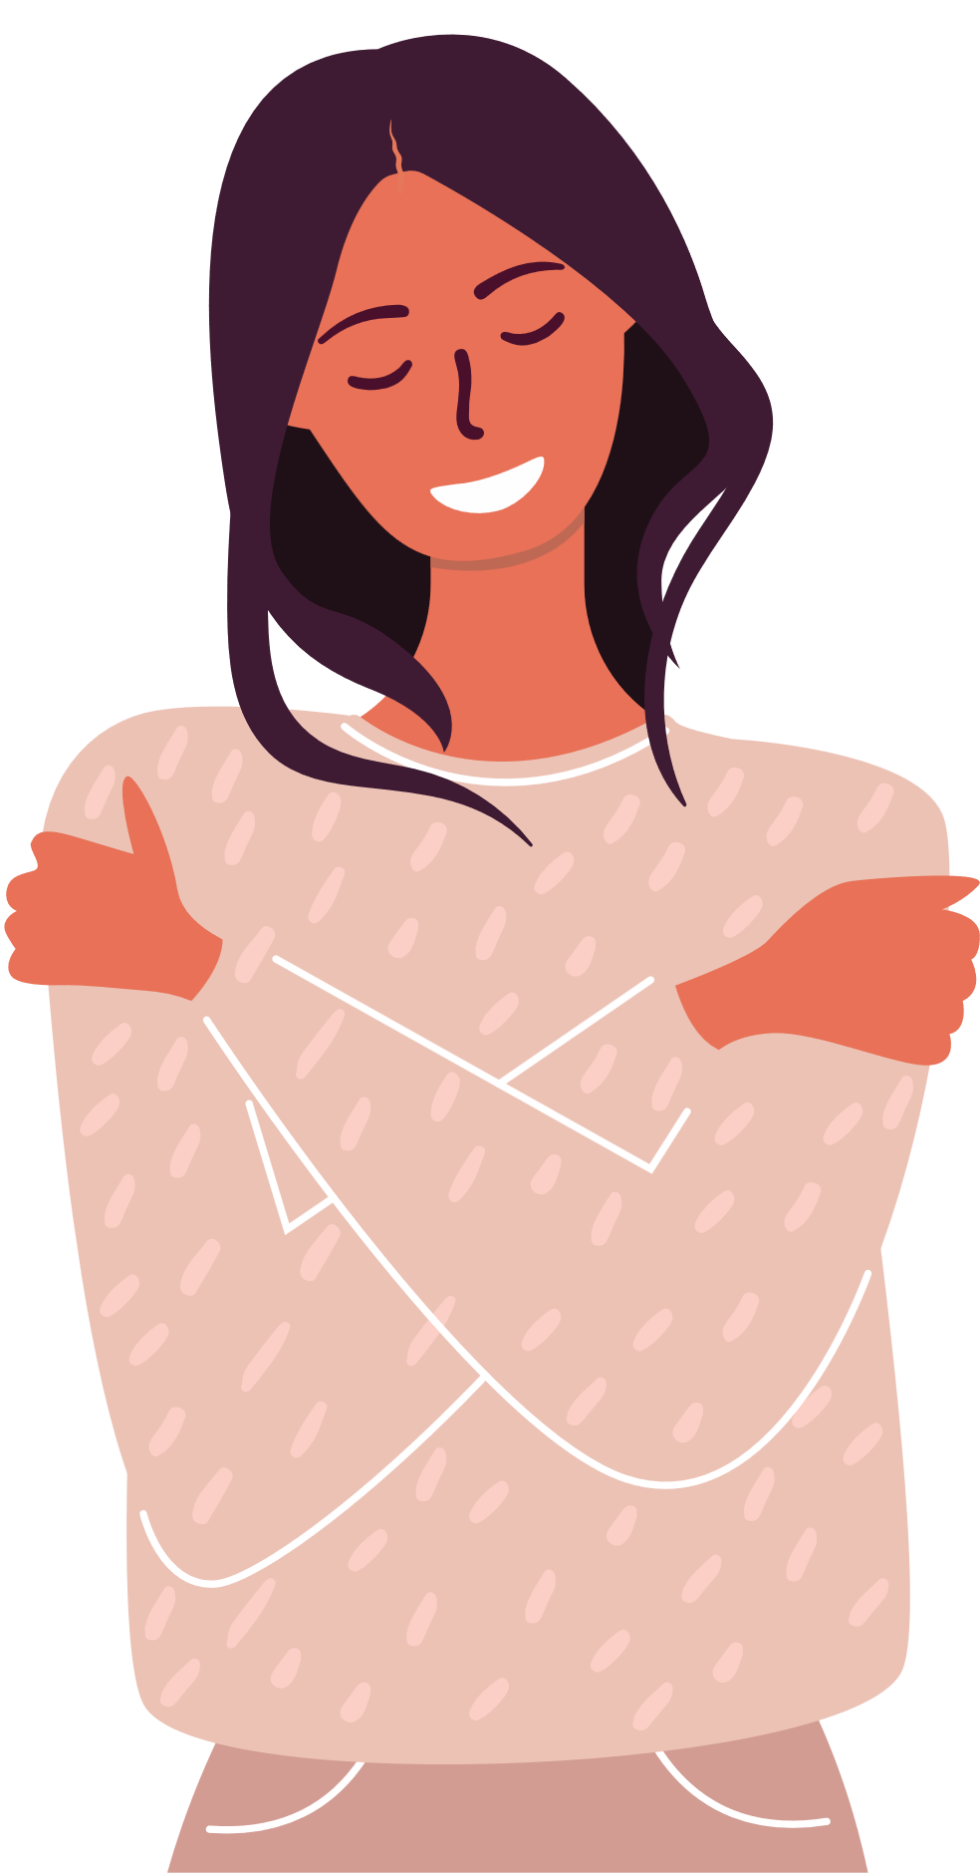
KINDNESS GROWS CONFIDENCE
Helping others boosts your
self-esteem and makes you feel good about yourself
Notes:
Explain that the great thing about kindness is that it gives back! When you are kind to others, you end up feeling happier and more confident!
Have students give themselves a hug and say “I AM KIND”

Slide 5


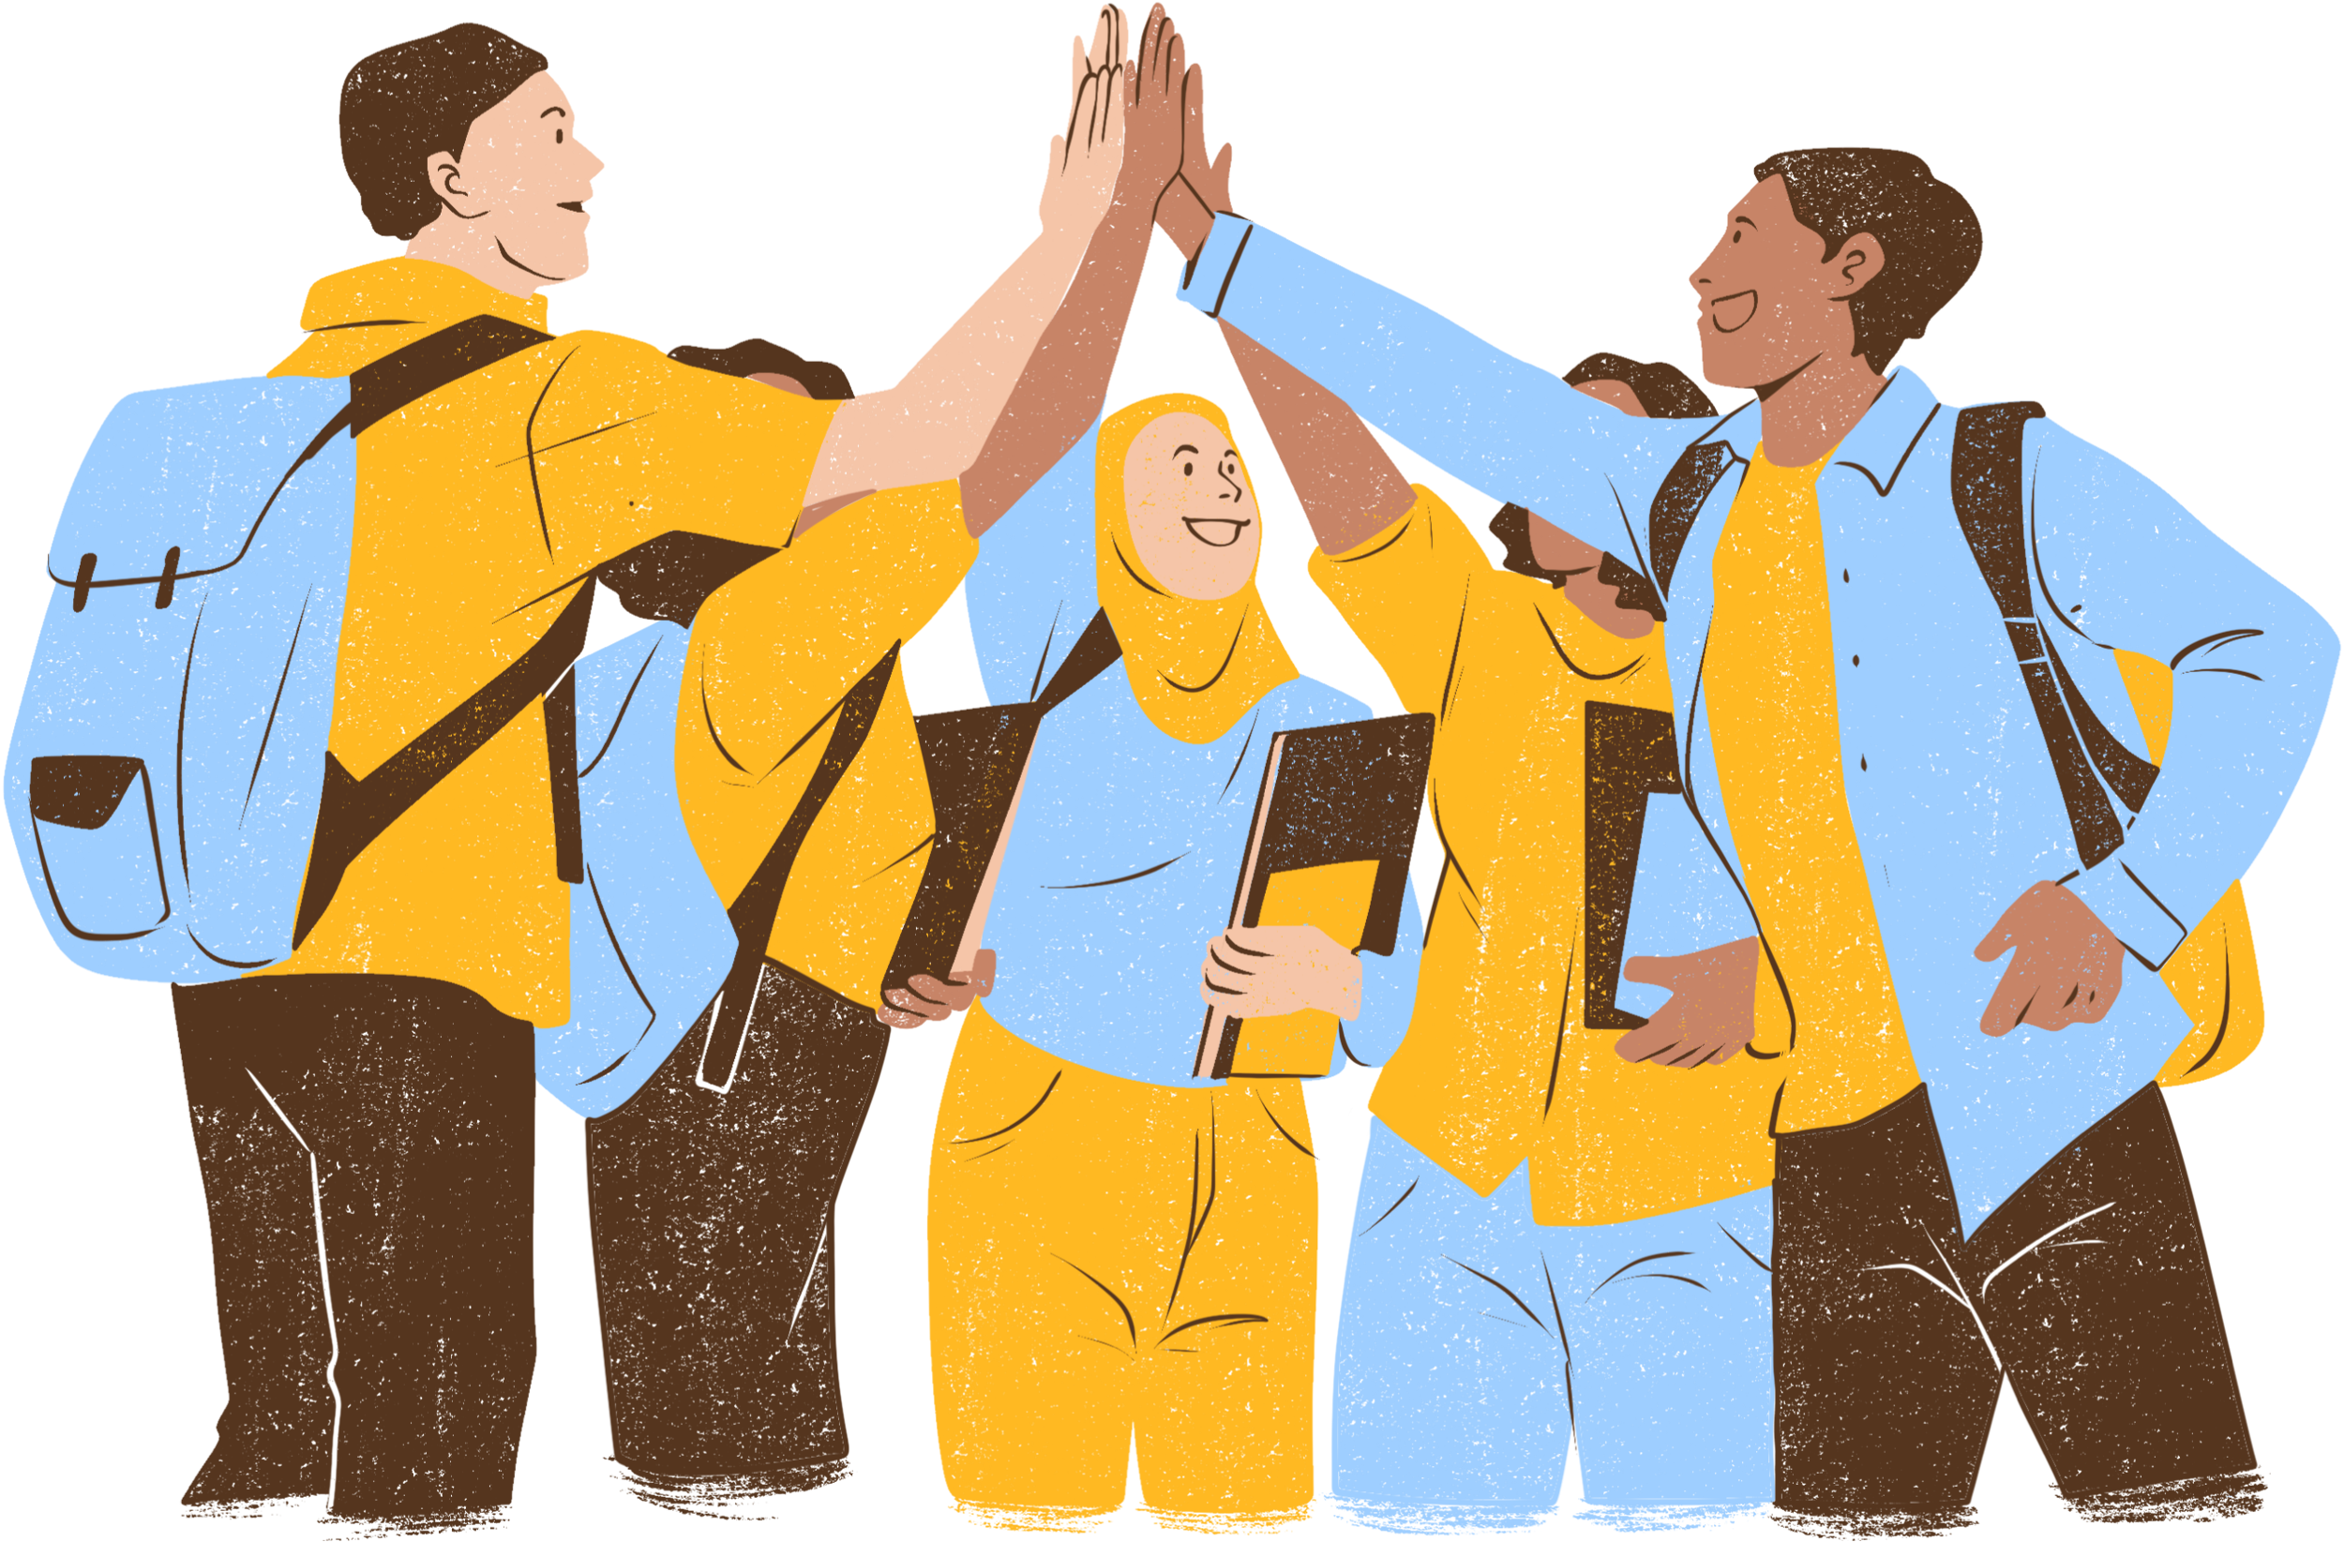


KINDNESS GROWS FRIENDSHIPS
People like being around kind people, so you make more firends!
Notes:
Have students share who their best friends are and why. Have several students answer
Explain that it’s the small things that our friends do like share, play with us and make us laugh that make us love having them around. Each of us can be that person for someone else and you can grow your friendship circle
Give the idea that something small like giving each other a high five to celebrate each other’s accomplishments can help grow friendships! Invite them to give a high five to the person to the right of them, now the person to your left!

Slide 6


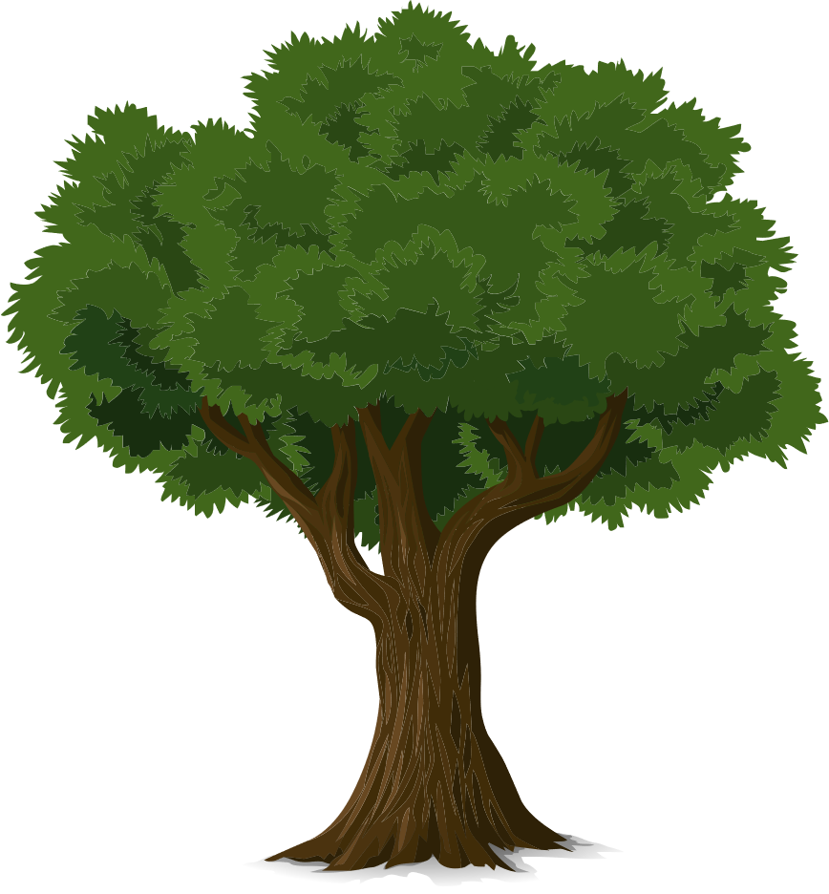

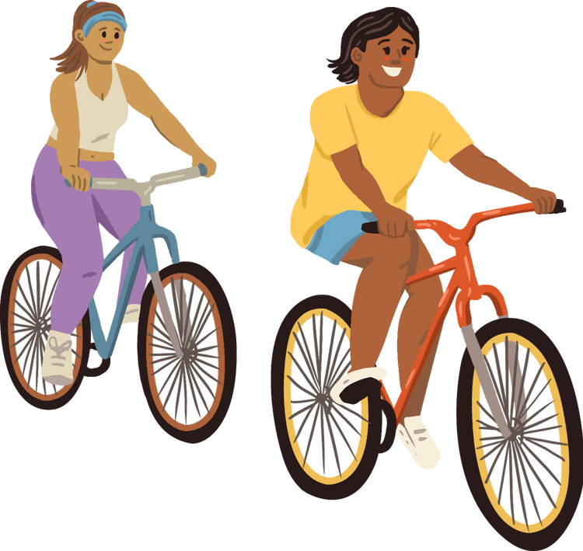
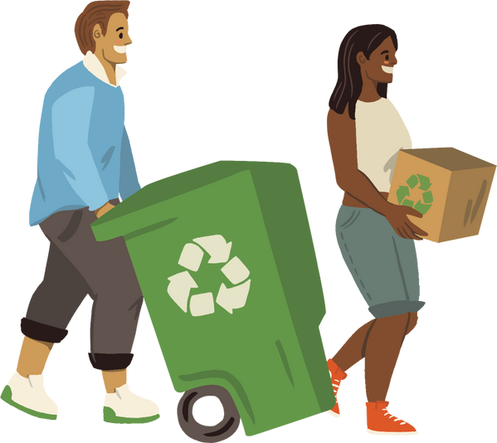
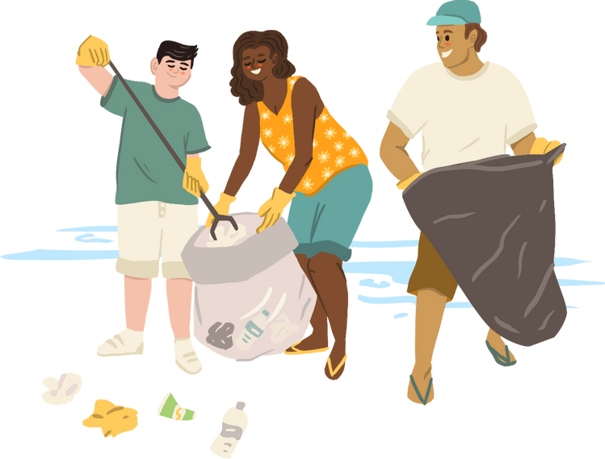

KINDNESS GROWS
STRONGER COMMUNITITES
Kindness spreads and makes schools, families, and towns better places
Notes:
Explain to them that they can have an impact not only at school but also with their families, when they are at the store, in the park, with their neighbors, etc.
Ask them what kind acts they can do at home. Have several students answer
Explain that when we work together to be kind our communities grow stronger

Slide 7





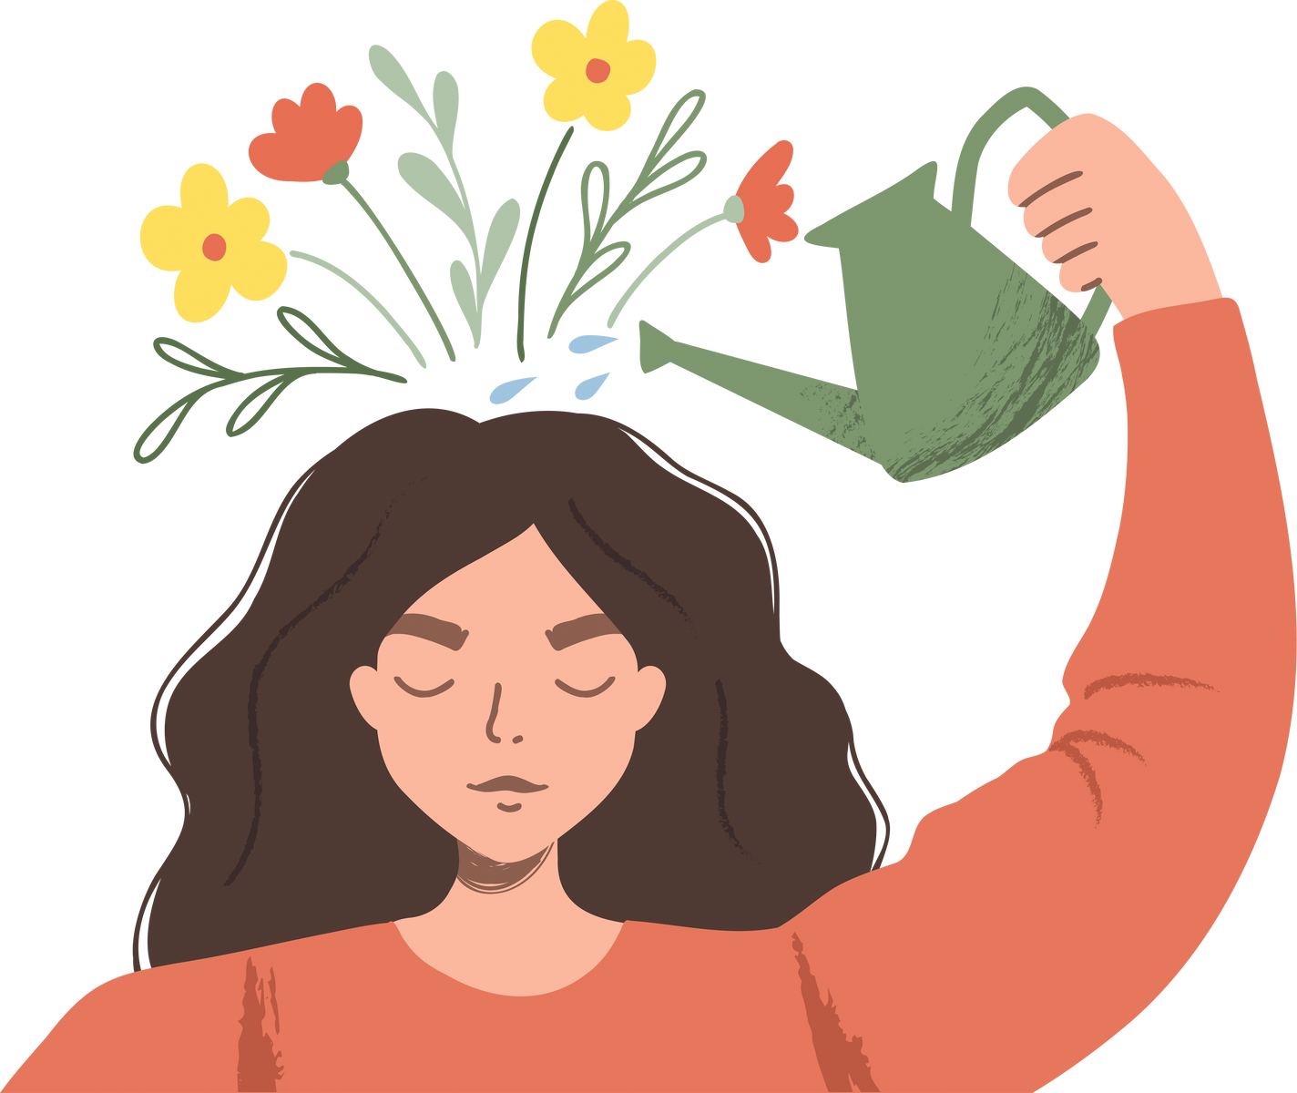

KINDNESS GROWS YOUR MIND
Being kind helps you learn patience, empathy, and understanding
Notes:
Share that kindness helps you learn patience, empathy and understanding. Sometimes we encounter situations when someone is unkind to us. What do we do then? Do we forget about kindness and respond unkindly? No. We have to remember to take a deep breath and try to look beyond the bad and into the good.
When was a time that you had to be patient? Share with students or have them answer the question. Make them realize that patience is kind.
Explain what empathy means (the ability to understand and share the feelings of another). Explain that when someone is being unkind there is always a reason why they are acting that way. Give the example of when someone is hangry. They sometimes are irritable or mean just because they haven’t had food. We can be understanding of those situations and give them some grace and not get offended

Slide 8


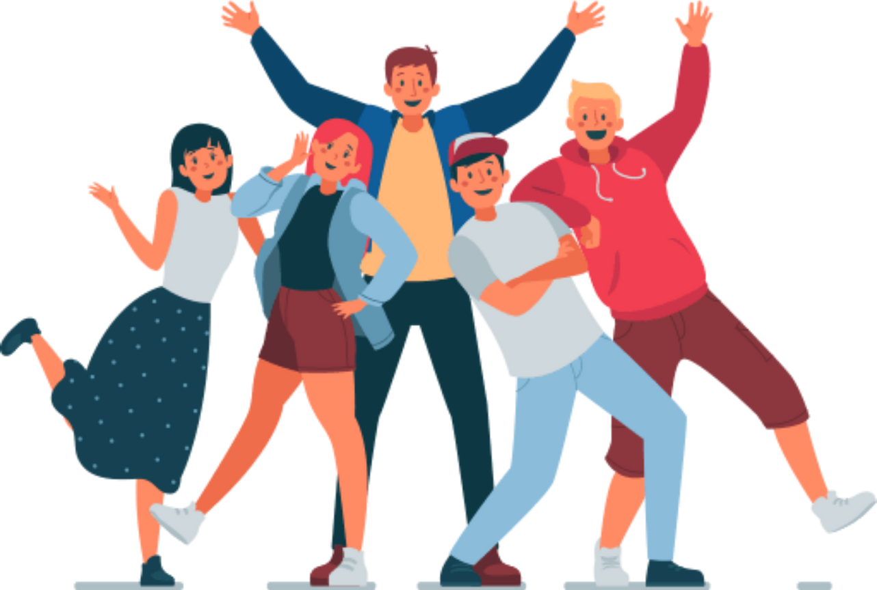


KINDNESS GROWS HAPPINESS
Acts of kindness release “happy chemicals” in your brain, making you feel good
Notes:
Talk about the happy chemical serotonin that is released when we are kind that makes us happy!
Add that it makes you and others around you happier. Have everyone show their biggest smiles! Say something like “Oh I love all those smiles! I bet your parents and teachers love those smiles too!”
Have them turn to a partner and give them a compliment. Give them positive options like “I like your hair” or “thanks for being my friend” or “you are really good at math”
Then ask them how they felt saying kind things to others?

Slide 9
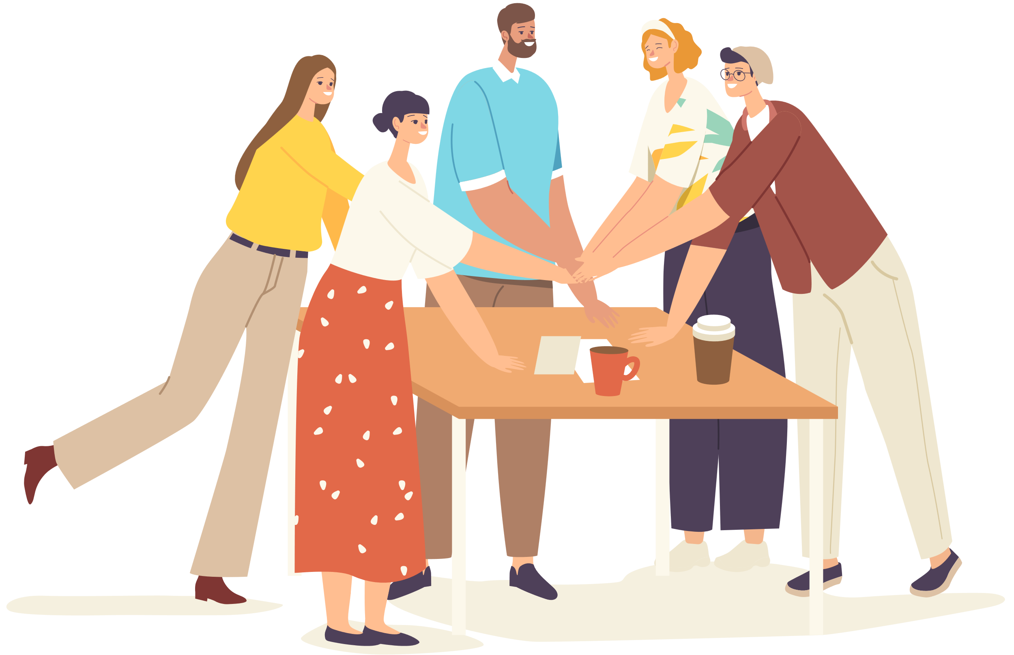
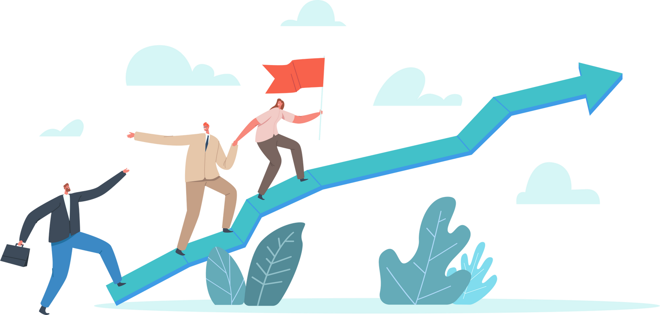
KINDNESS GROWS
YOUR FUTURE
Kind people become great leaders, teammates, and role models
Notes:
Ask them what they want to be when they grow up. Have several students answer
Help them understand that if they learn to be kind now while they’re still young, it’ll help them achieve their dreams and they can be the best doctors, firefighters, astronauts ever!
Kindness doesn’t just help right now but will help your future as well

Slide 10

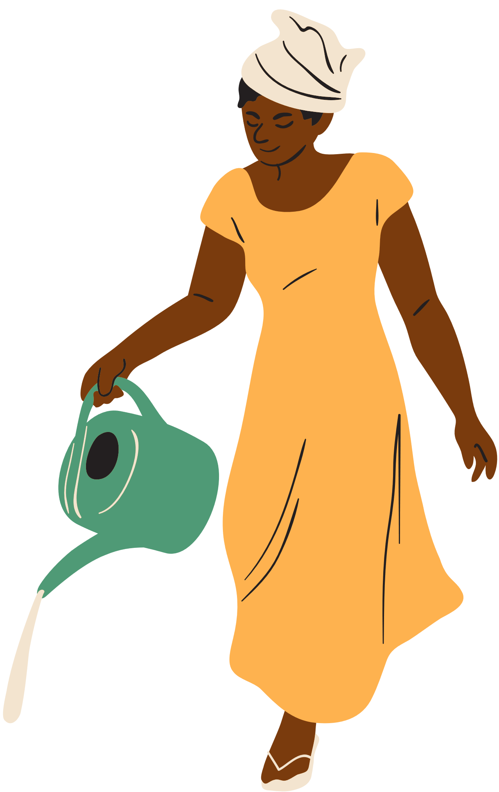


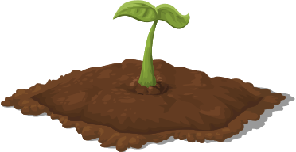
KINDNESS GROWS LIKE A TREE
Daily acts of kindness is like the daily water and sunshine needed for a seed to grow into a tree. The more kindness you show, the more it spreads to others!
Notes:
For a tree to grow you need…? Ask the students to finish your sentence
They will hopefully answer sun, water, etc
Explain that kindness isn’t just something we do once a year and then you’re done but that it’s something you need to do daily (hence the name One Kind Act a Day). Daily acts of kindness help our kindness tree to grow and trees give shade, make the world more pretty and they can also give fruit. All of these things help others! That’s the whole point of kindness! You gotta spread it!
Have them repeat the activity from the very beginning where they squatted down into a ball and then rose up with hands stretched out like a big tree and have them say “KINDNESS GROWS!”

Slide 11




KINDNESS GROWS THE WORLD
If everyone is kind, the world becomes a better and more loving place!
Notes:
Explain that they can help the world to grow with their kindness and that it all starts with just one kind act and that act turns into 5 which then multiplies to 25 and then to 100 and kindness just keeps spreading from person to person and by the end of the day you can change the world and impact so many people.
Remind them that there can be a lot of crazy things happening in the world or at home but that when we choose to be kind we stay happy and help others find happiness too!
Have them all stand up, hold hands and say “TOGETHER WE CAN CHANGE THE WORLD” and then have them say “ONE KIND ACT A DAY!”
End with any other concluding thoughts

